Slide 1

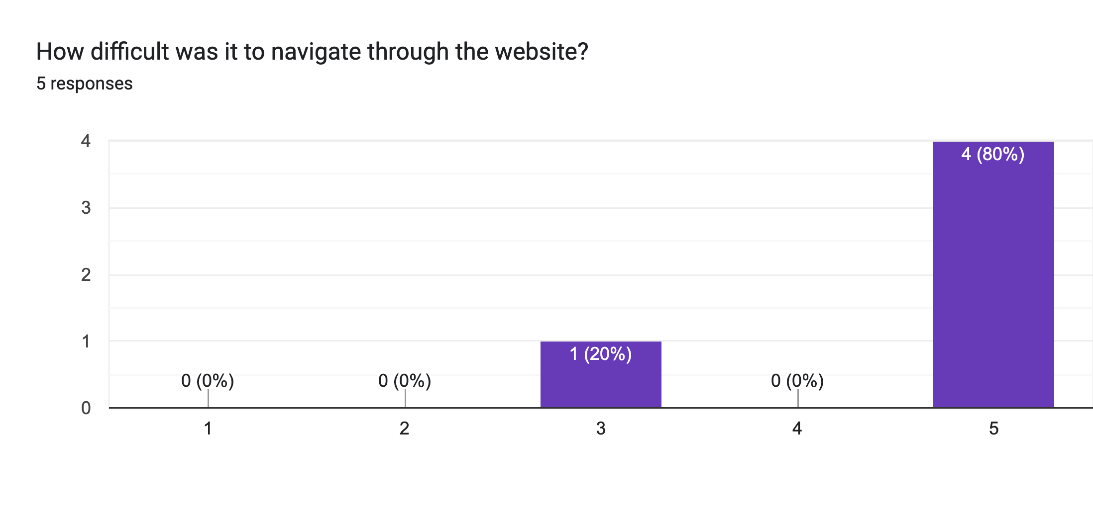
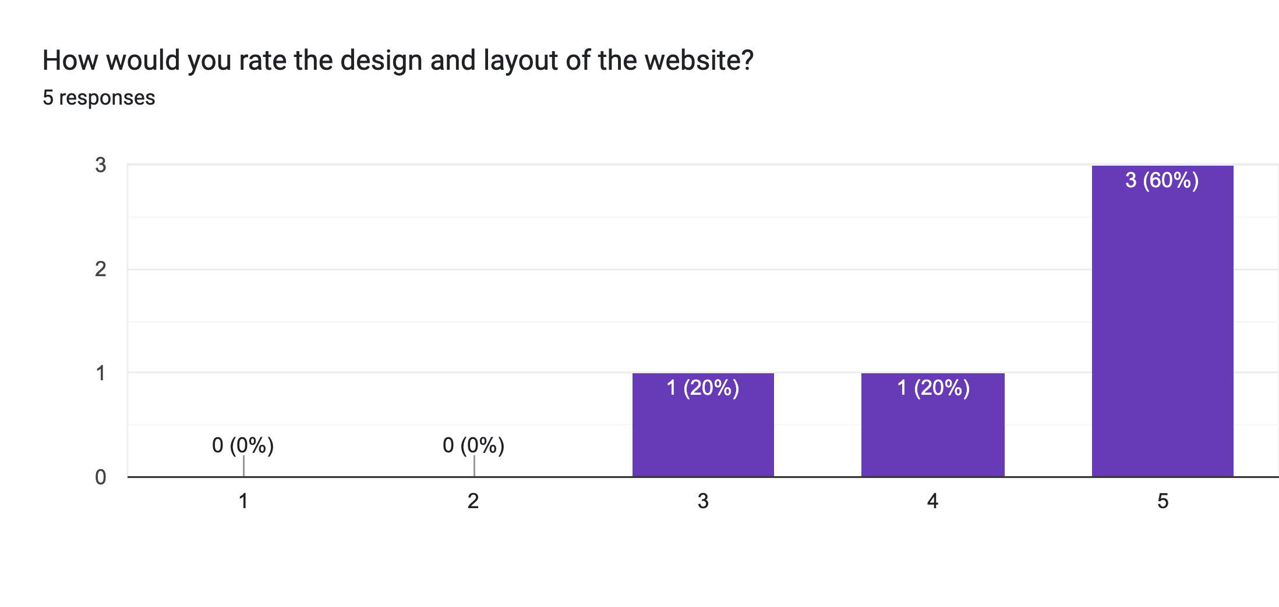
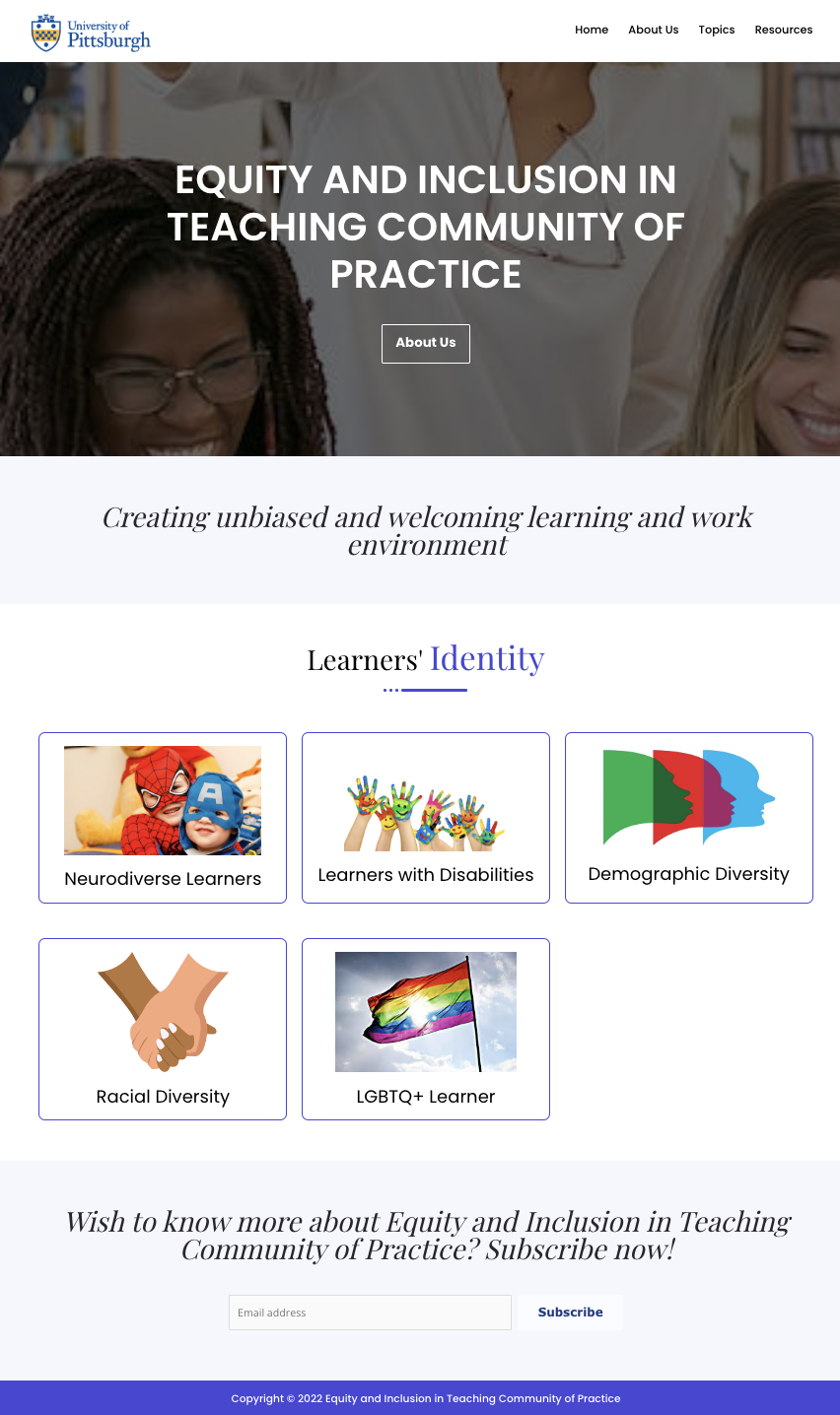
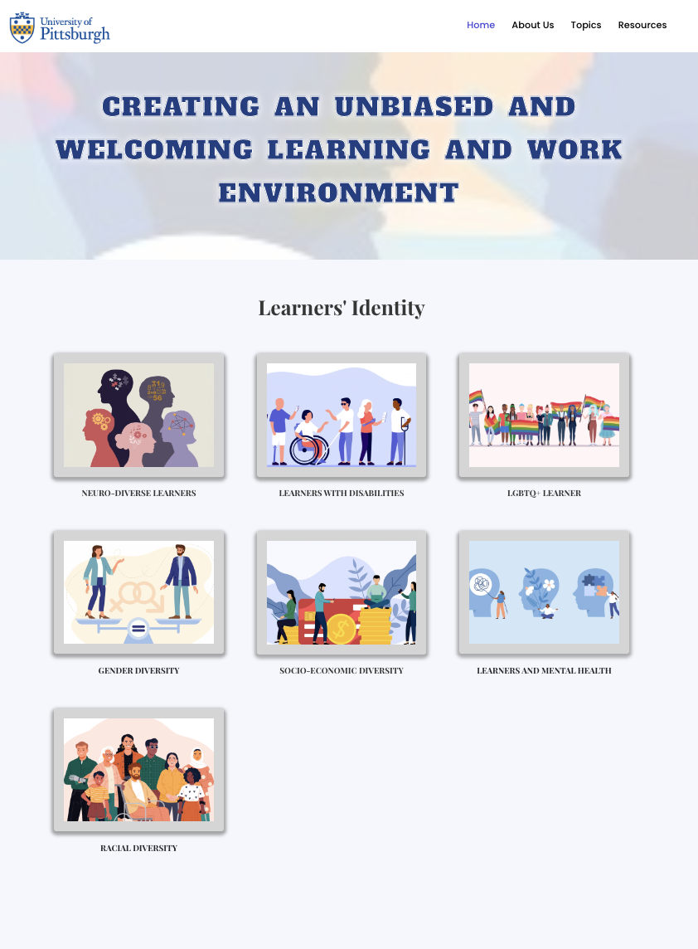

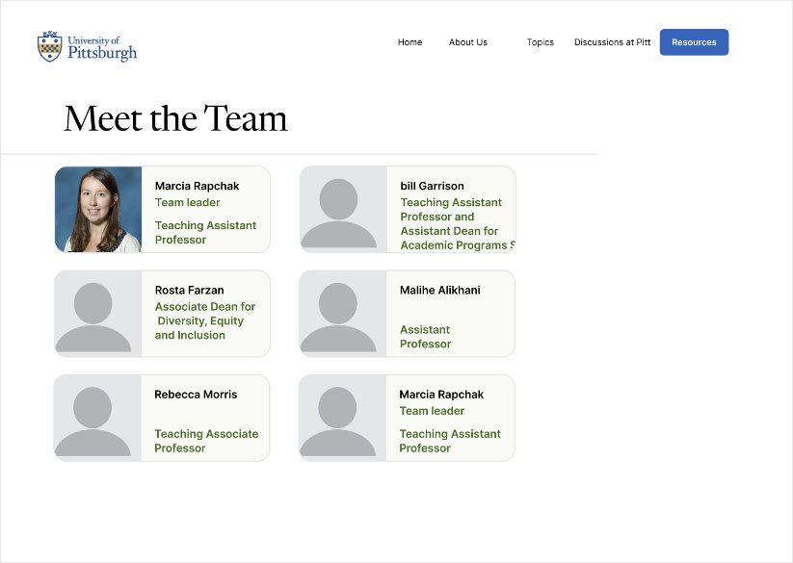
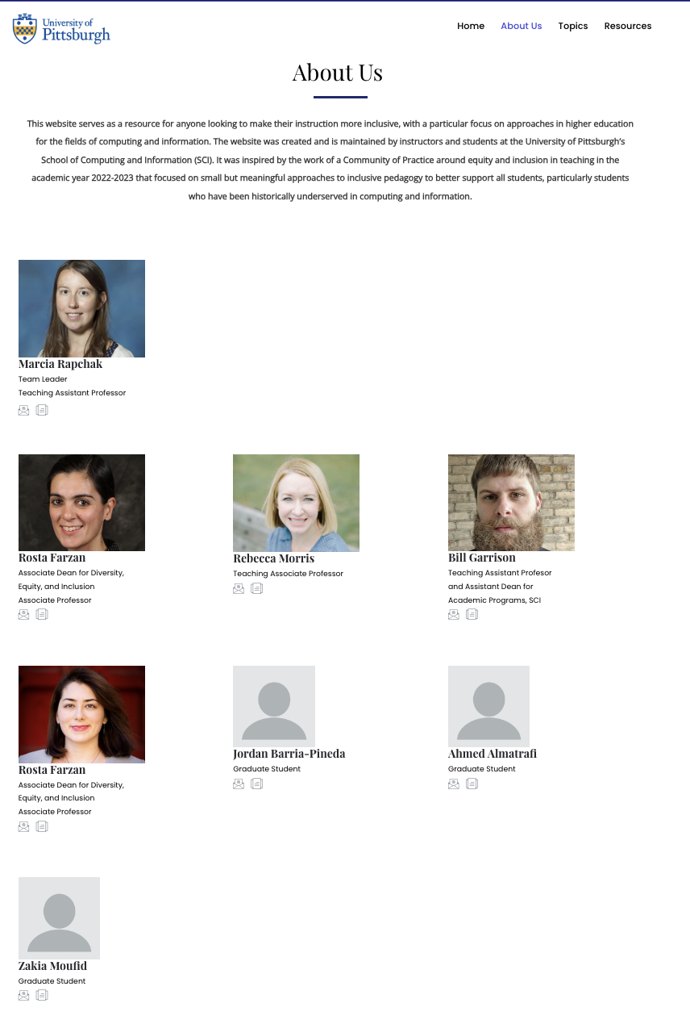
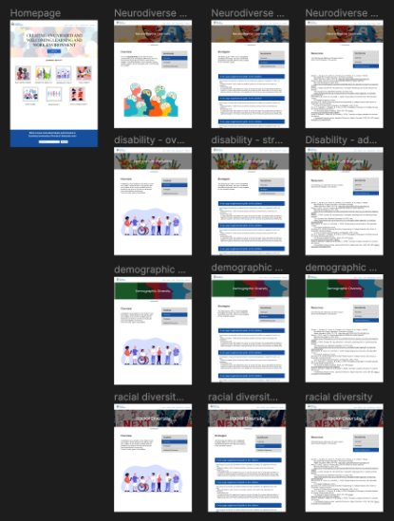
Website Redesign and Content Integration for Inclusive Teaching
Sadhana Boddhula, Jessica Dang, Courtney Kowaluk
University of Pittsburgh Computer Science
Abstract
Methodology
Results
Conclusion
Redesigning the University of Pittsburgh's Inclusive Teaching website aims to enhance functionality, content, and aesthetics, catering not just to local faculty but educators everywhere. By streamlining design and navigation while enriching content, our aim is a user-friendly platform for accessing inclusive teaching resources promoting an environment where all students can thrive in the classroom. Usability tests will refine user experience, with plans for accessibility features and live updates on related events. Detailed project planning ensures clear milestones and deliverables, setting expectations for a complete transformation of the website. With a renewed focus on inclusivity, the website will serve as a cornerstone for fostering diverse and equitable learning environments, empowering educators to meet the needs of all learners.
During the development of our project, we engaged a diverse group of participants from the School of Computing and Information, including undergraduates, PhD students, teaching assistants, and professors for usability testing. This ensured a broad spectrum of viewpoints and requirements could be addressed. The user testing was conducted using the think-aloud protocol, where we recorded participants as they interacted with our website prototype that was built in Figma. This method allowed us to observe real-time reactions and gather specific feedback on their experience throughout the testing process. We then conducted a survey to get feedback from the users.
From the results, we transcribed and analyzed the recordings to pinpoint critical areas for improvement. This data has highlighted specific user needs and preferences, which we are actively incorporating into our website redesign. Changes were made to enhance site navigation and the overall user interface, ensuring that the final product not only meets but exceeds the expectations of our diverse user base. This approach to user testing is guiding our efforts to tailor the website effectively to suit the needs of all users.
After we had edited the changes, we performed a second round of usability testing which demonstrated significant improvements in user satisfaction and interface usability. Participants from the initial round were invited back to assess the revised prototype, along with new users to ensure a fresh perspective. This subsequent phase of testing helped us in validating the changes made, as feedback confirmed that the modifications effectively addressed the previously identified pain points.
The results of our usability testing shows that overall, users seem to be more satisfied with the design and layout of the redesigned website. The users had fewer critical incidents involving difficulty navigating through the website to complete specific tasks than the initial round of testing.
In conclusion, the redesign of the University of Pittsburgh's Inclusive Teaching website has demonstrated substantial improvements in its functionality, informativeness, and user engagement. Through two rounds of usability testing, one before and one after changes were made, we have effectively refined the website's design, enhancing both navigation and the overall user experience. The feedback from both initial and new participants in the second round of testing has been positive, affirming that our targeted adjustments have successfully addressed the critical areas previously identified for improvement. The redesigned website now offers a more intuitive and professional platform, which allows for seamless access to resources and information pertaining to inclusive teaching.
Furthermore, user feedback and technological advancements shaped the evolution of the project and allows it to expand in the future. We are committed to maintaining a proactive approach to updating and refining the website, ensuring its continued relevance and effectiveness as an educational resource. By fostering collaboration with the sponsor and maintaining active engagement with the website's user base, we implemented enhancements that meet the evolving needs of educators and students alike. This iterative process enhanced the website's usability and will continue to contribute to the advancement of inclusive education practices both within the University of Pittsburgh and beyond.
Looking ahead, we envision the website serving as a dynamic hub for fostering dialogue and collaboration among educators, researchers, and students in the field of inclusive education. The website serves as a center for resources regarding diverse types of students and how to best tailor their education experiences and will continue to grow. The dynamic nature of the website allows members of the department to update and modify pages and information, allowing them to keep the information up-to-date and add additional content. Through these initiatives, we aspire to make a lasting impact on the landscape of inclusive education, empowering educators to create equitable learning environments that benefit all students.
Survey results from preliminary user testing
Introduction
The project aims to redesign the University of Pittsburgh's Inclusive Teaching website to enhance its functionality, informativeness, and visual appeal. While currently tailored to faculty at the University of Pittsburgh, the objective is to transform it into a valuable resource for educators and teaching assistants beyond the university. The desired outcomes include a more cohesive design, improved navigation, functional links, and relevant content. Design objectives prioritize professionalism and ease of use, with flexibility for adjustments based on usability testing. The sponsor, Dr. Marcia Rapchak, wanted to improve data intake for easier content management and plans to use the website as a central hub for inclusive teaching resources. Usability testing with students and staff will ensure a positive user experience. A timeline and set goals were established in collaboration with the sponsor to guide the project's progress. With a commitment to accessibility and inclusivity, the website will serve as a catalyst for creating equitable learning environments both within and beyond the university community, fostering collaboration and knowledge sharing among educators nationwide.
Before and after of website front page.
Before and after of About Us page.
Throughout the process of the redesign, we met with our sponsor and received feedback at every step. This led to quite a few changes; combined with our usability testing feedback, we were able to make changes to the design and functionality that removed unnecessary sections from the website and improved the ease of use in the remaining pages.
The result is a website that is visually appealing with improved usability, allowing the website to be a better and more effective resource for inclusive teaching materials.
Acknowledgements
Thank you to Dr. Marcia Rapchak, our sponsor, Dr. Bill Garrison, our professor, Dr. Rosta Farzan, the Associate Dean of Diversity, Equity, and Inclusion. Thank you to all of the users that participated in usability testing.
Prototype built in Figma for usability testing.

